Slide 1
اهتمام "دورة تدريب طاقم العمل "

Slide 2
المقدمة
لماذا نحن هنا (ما الهدف من التدريب)
STOP لماذا التغيير من
الفترة التجريبية لاهتمام
Notes:
Firstly introduce yourself, shake their hand and create a friendly open atmosphere. Give your name and designation and allow whomever is assisting you to do the same.
Do the Safety Induction / share or ask the team to share any safety moments/observation, etc..
Inform them that you are here today to train them on Ihtimam, and that it is an interactive session and you would appreciate their participation.
Allow them to introduce themselves to you and try to make a point to remember their names.
Inform them that you will now start the training.
Be sure that you inform them of any critical safety information (fire exits, drills, smoking areas etc depending on where you are hosting the training.
Lets begin:
Would you agree that we work in a hazardous environment? Are there many risks around us? Do we have measures in place to mitigate these risks? So why do we still have incidents?
Is it peoples behaviors? 98 % of incidents occur due to peoples behaviors. However that is the IMMEDIATE cause and not the root cause. If you were to dig deeper you would find several contributing factors from behaviors, to equipments that contributed to the incident.
Previously Behavior based safety (STOP or equivalent) only looked at behaviors of an individual, as time has passed, BBS has evolved. It has become about a cultural change rather than 1 persons behavior. And that is what I am here to explain to you today.
Changes between STOP and Ihtimam
STOP:
ONE FITS ALL APPROACH.
FOR FIELD STAFF ONLY.
ORIGINALLY LIMITED TO SUPERVISORS.
GENERIC OBSERVATION CARD.
OBSERVATION CARDS NOT FOCUSED.
TRAINING SPECIFIC FOR SUPERVISORS CASCADED TO ALL STAFF.
PRODUCT DILUTION OVER TIME.
DATABASE NOT USER FRIENDLY.
NO ACTION TRACKING.
QUANTITY OVER QUALITY.
Ihtimam:
CUSTOMIZED APPROACH.
INCLUDES OFFICE PERSONEL.
VERY SIMPLE.
DESIGNED THROUGH ENGAGEMENT OF STAFF.
OBSERVATION CARDS ARE LIMITED TO 5 FOCUS AREAS.
OWNERSHIP OF SYSTEM WITH SUPERVISOR.
COMPREHENSIVE ONLINE DATABASE.
ONLINE ACTION TRACKING.
TRAINING SPECIFIC TO AUDIENCE.
5 LEADING KPI’S MEASURE EFFECTIVENESS
Ihtimam Pilot
Ihtimam has already been piloted in (Rig97/95, Hoist 103/105, Carillion Nimr and Marmul ) and has proven to be very successful. People appreciated its simplicity, its improvement in communication and the fact that it was not focused on an individual but on the root causes, and more importantly that actions were getting closed out and monitored.
As Ihtimam is a product that has been created jointly between PDO and Contractors, PDO BBS team is always open to hearing your suggestions to help it work for you. So keep that in mind throughout the training and you can let me know if you would like to share something at any time.

Slide 3
السلامة القائمة على السلوك؟
ما هي السلامة القائمة على السلوك؟
(BBS system)
عملية الملاحظة (طريقة لفهم لماذا يتصرف الناس بالطريقة التي يتصرفون بها)
الطريقة التي نؤدي بها الأشياء هنا (في بيئة العمل)
أداة لجمع البيانات لدراسة جودة نظام إدارة السلامة في الشركة
Notes:
An observation process, which is basically the observation cycle (Observe, Feedback, Document, Close Actions, Analyze). It is our means to understand why people do what they do and try to eliminate root causes.
The way we do things around here….do we mean what we say? Do we walk the talk? Is safety really a priority or something we must do? do we own safety? Do we set standards above the minimum requirements? Do employees believe what we tell them?
The database gives us the ability to upload and store data for analysis, if we analyze the right things we will be able to determine our gaps, concerning behaviors, and our overall performance. It is also an essential piece to our continuous improvement.

Slide 4
القيادة في مجال السلامة وثقافة السلامة
القلب والعقل
المهارات القيادية
الإجراءات اليومية
العامل النفسي
العامل السلوكي
كيف يفكر الأشخاص ويشعرون تجاه السلامة معتقداتهم وتوجهاتهم
ما الذي نفعله يومياً لتحسين السلامة
أنظمة الإدارة
العامل الظرفي
هذا ما تفعله الشركة لإدارة السلامة، كما تشمل عدد كبير من المجالات مثل البيئة الطبيعية وأنظمة الإدارة والاتصالات والمراقبة والضوابط والمصادر وغيرها.

Slide 5
السلامة القائمة على السلوك
السلامة القائمة على السلوك
ليست فقط حول الملاحظات وردود الفعل
لا تتعلق فقط حول سلوك موظفي الخط الامامي
لا تركز على معدلات الحوادث فقط
ليست بديل عن تقنيات إدارة المخاطر التقليدية
لا تستخدم لإلقاء اللوم والعتب على الناس
ليست عملية لا تتطلب مشاركة الموظف.
Notes:
Many people think BBS is only about observation and cards, this is far from what BBS actually is. BBS should be viewed from a wider angle, to benefit the entire organization. Not just one individual who probably behaved the way he did for a reason. BBS is progressed to focus more on management systems and the working interface instead of the individual.
As mentioned in the previous slide, BBS is about how we do things around here, and that means everyone in the organization, safety effects as all.
Incident rates should not define a BBS system, BBS is focused on people and understanding why they do the things that they do, many additional components can contribute to an incident regardless whether people are trained in BBS or not.
Just as the previous point, BBS will not stop incidents from occurring if other factors are not well controlled. We cannot have employees in an unsafe environment working with unsafe equipment and expect them not to have an incident because you have a BBS system in place.
BBS is a no blame process, workers do not intend to harm themselves, blaming the worker or manipulating someone who raises an observation against you will not help you, the individual or the organization in reducing incidents.
BBS involves everyone, from top management, mid management and the front line workers, without one, the company would not cease to stand, and therefore everyone needs to be onboard in the pro-active effort to reaching sustainable excellence. Involving stakeholders is key in anything you do, and 90% of the time the stakeholders are your frontline workers.

Slide 6
STOPالفرق بين اهتمام و
STOP
IHTIMAM
يناسب كل النهج (بطاقة واحدة لكل الأقسام)
للموظفين الميدانيين فقط
كانت مقتصرة فقط على المشرفين
بطاقة الملاحظة العامة
التدريب مقتصر على المشرفين
تخفيف البرنامج على مر الزمان
قاعدة البيانات ليست سهلة الاستخدام.
لا يوجد متابعة للإجراءات المتخذة
الاهتمام بالكمية اكثر من الجودة
البطاقة مخصصة لكل قسم بطاقة خاصه
تشمل موظفين المكاتب
بسيطة وسهلة جدا
مصممة من خلال إشراك الموظفين
تقتصر بطاقات الملاحظات على 4 الى 6 سلوكيات حرجة
ملكية النظام مع المشرف
قاعدة بيانات شاملة
متابعة مستمرة للإجراءات المتخذة
التدريب مخصص على حسب الموظفين
توجد 4 مؤشرات أداء لقياس فعالية البرنامج
Notes:
The development of Ihtimam was a 3 year journey. It began in Aug of 2015 when steer from PDO directors steering committee gave direction to develop a in house behavior based system for PDO and its contractors. As there was many frustrations with previous systems that did not work.
The Behavioral safety team began to assess previously used BBS systems within PDO as well as: deep dive reports, safety culture reports, visits to site, engagements with contractors, and review of several BBS case studies and best practices.
A blue print was then presented in March 2016 and was endorsed by the PDO directors steering committee.
In January of 2017 the PDO BBS team along with 3 other contractors launched a pilot in 6 locations at site for 8 months.
At the end of the 8th month a sustainability review was conducted that proved the success of the system and endorsement was given to start rolling it out across the organization.

Slide 7
اساسيات نظام ”اهتمام“
مراقبه
مراقبه
اعطاء الانطباعات
توثيق البيانات
تنفيذ النتائج
تحليل البيانات
التحسين المستمر
التحسين المستمر
راقب الاشخاص او المجموعات
وقت تنفيذ اي من الاعمال
اعمل على تحسين النظام ليعمل بكفائه عاليه.
1
اعطاء الانطباعات
6
2
اعطي انطباعك البنّاء مع محاوله فهم الاسباب الجذريه لسلوك ما.
تحليل البيانات
توثيق
حلّل البيانات بشكل دوري لاستخلاص ما يجب التركيز عليه.
5
3
وثّق الملاحظات في قاعده بيانات
4
تنفيذ النتائج
نفّذ ما تم نقاشه.
Notes:
Now that we covered the ABC analysis and have an understanding for behaviors we will move onto the foundations of Ihtimam.
The IHTIMAM observation cycle consists of 6 main steps.
1 – Observation
2 – Giving feedback
3 – Data capture
4 – Closing out actions
5 – Analysis of data
6- Continuously Improve

Slide 8
تحديد مستوى النجاح
الإجراءات التصحيحية المنجزة
نسبة الأمان
جودة الملاحظات
جودة ردود الفعل المعطاة

Slide 9
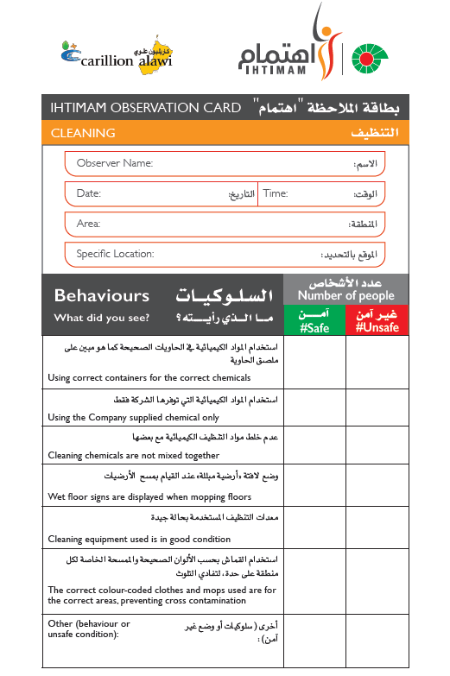
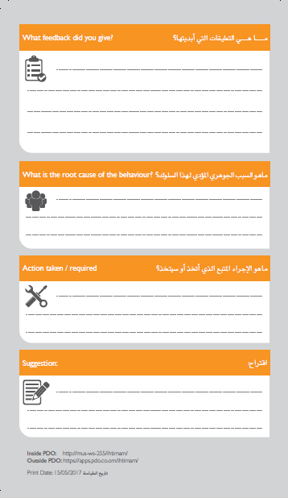
بطاقة اهتمام
تقتصر كل بطاقة ملاحظة على 4 – 6 سلوكيات محددة. هذا يجعل الأمر سهلا للموظفين للتركيز على السلوكيات الحرجة.
Notes:
Explain the elements of the card
Explain the ways to document the observation cards ( Phone , PC , Hard copy )

Slide 10
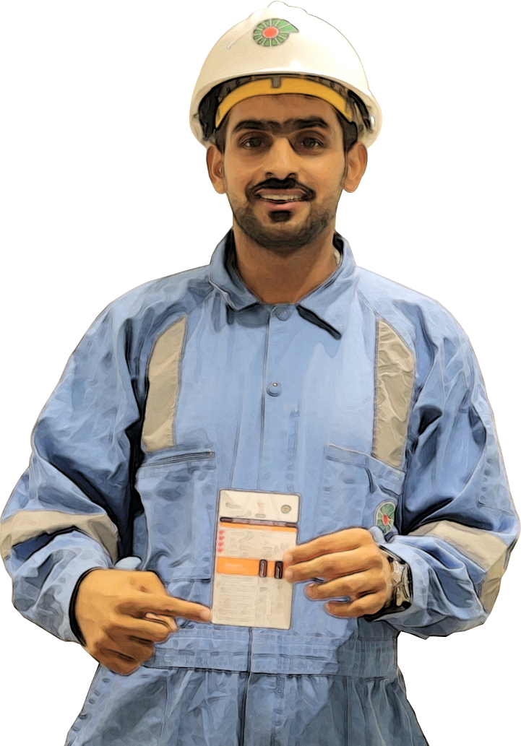
عمليه المراقبه
لا تختبئ
تأكد ان الجميع يراك وقت المراقبه, فالصحيح هو انك لست مطالب بتصيد الاخطاء
راقب
هل يعمل الجميع بطريقه امنه؟
هل ارى ما يقلقني؟
اسأل
لا تملي عليهم ما تعتقد وانما وجه اساله مفتوحه (كيف, لماذا)
عزز الايجابيات
اعطي انطباعاتك الايجابيه للممارسات الجيده
لا تركز في السلبيات فقط
عبّر عن ما يقلقك
بيّن مدى اهتمامك

Slide 11
تهانينا!
لقد أكملت دورة
اهتمام "تدريب طاقم العمل "
Congratulations!
You have completed the BBS Frontline Crew Training

